Slide 1
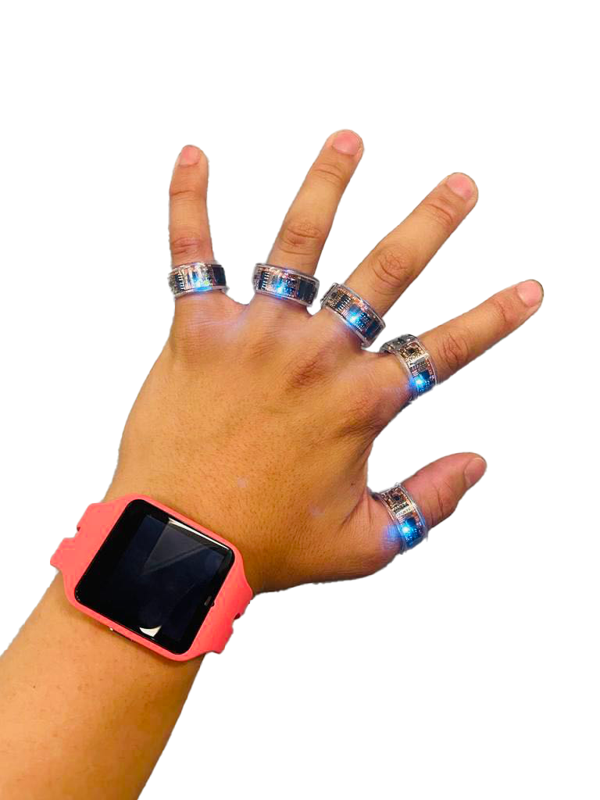

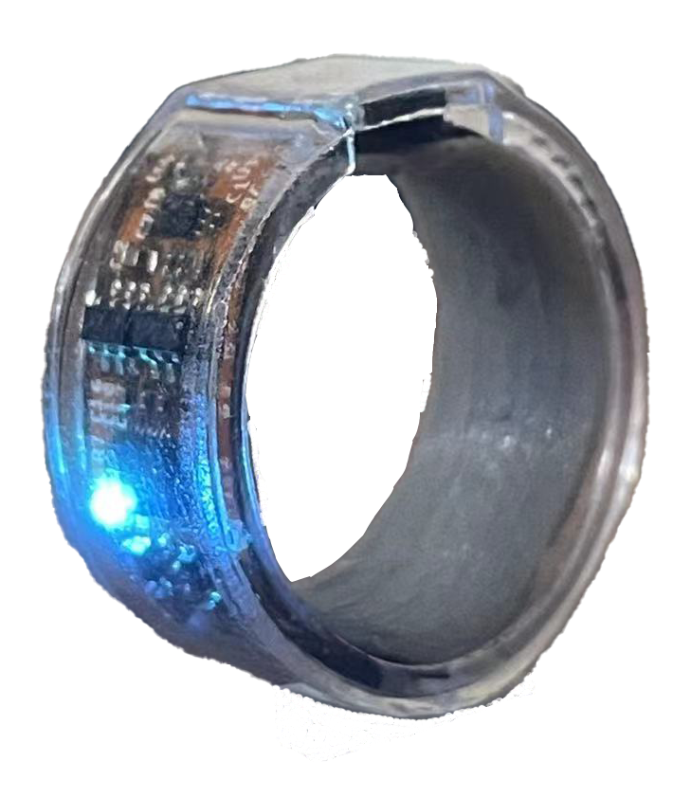
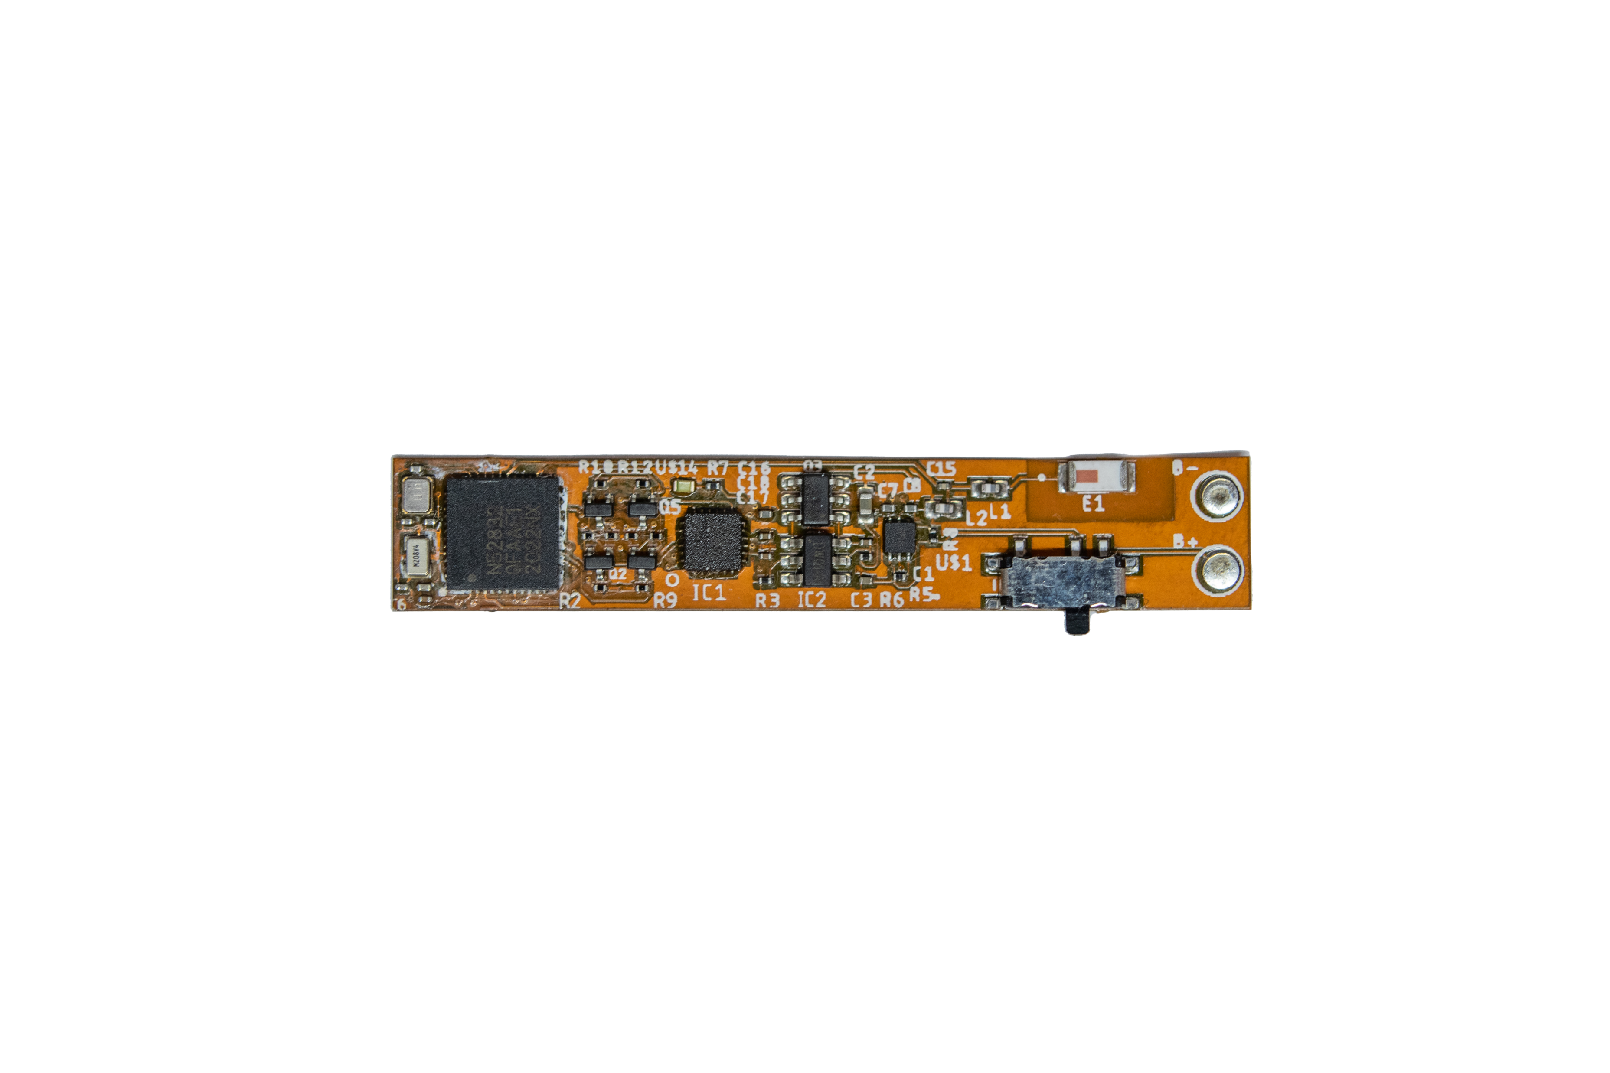
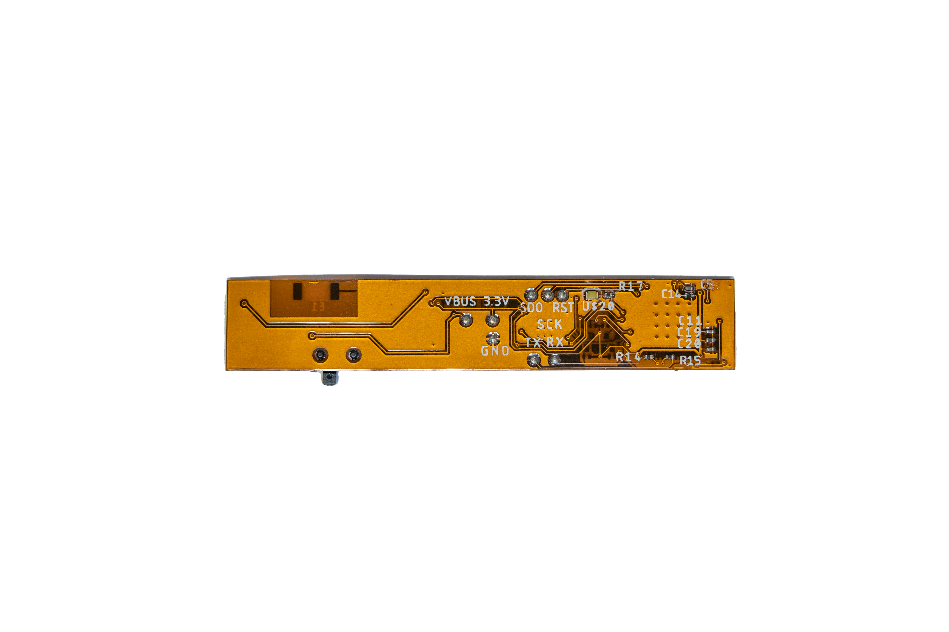
SPI
BLE
46.2 mm
Sensor Rings
9-axis
IMU
NRF52832
SoC
8.3
mm
Voltage regulator
Ring Diameter: 11mm
Battery: 15mAH
Weight: 2.8g
Lithium Battery
(a)
(b)
(c)

Slide 2
SPI
BLE
9-axis
IMU
NRF52832
SoC
I2C
PPG
Voltage regulator
Lithium Battery

Slide 3
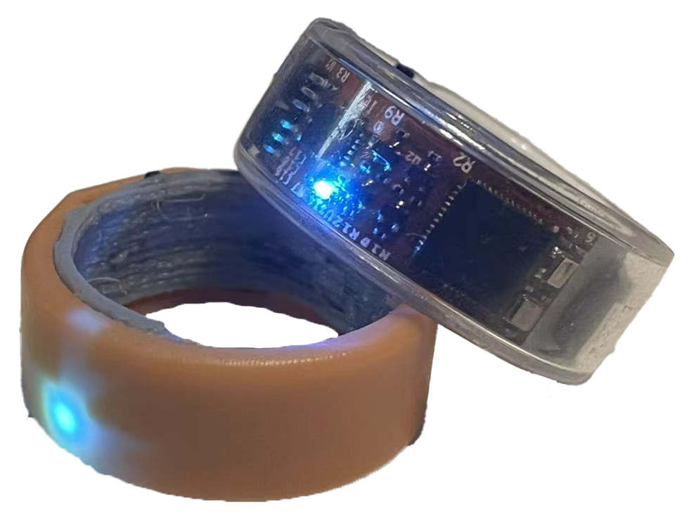
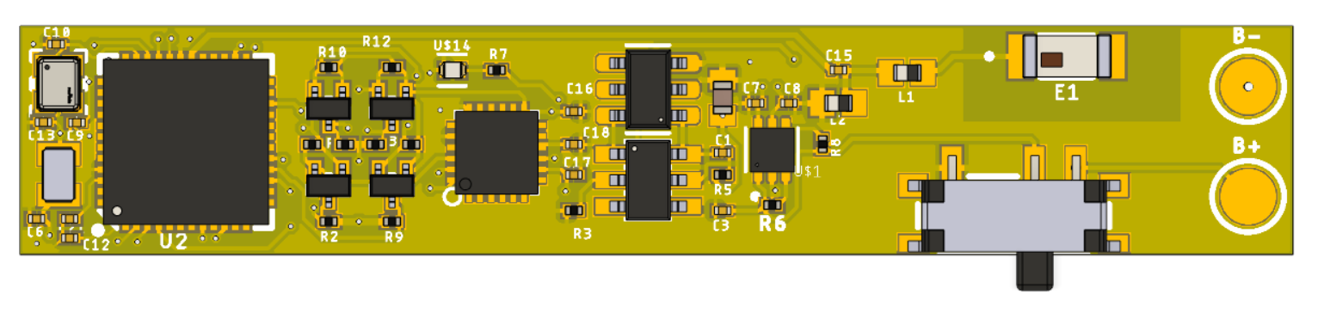
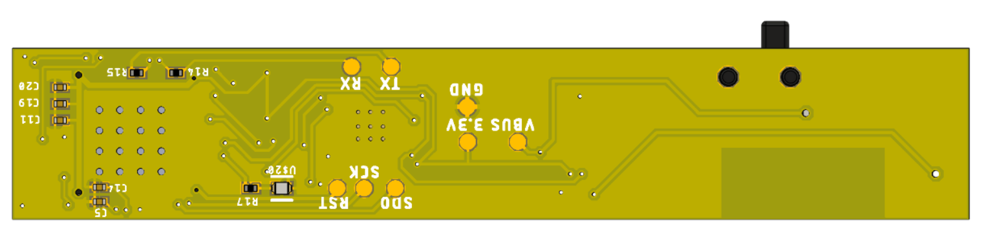
SPI
BLE
46.2 mm
Sensor Rings
9-axis
IMU
NRF52832
SoC
8.3
mm
Voltage regulator
Ring radius: 10mm
Battery: 15mAH
Weight: 2.8g
Lithium Battery
(a)
(b)
(c)

Slide 4
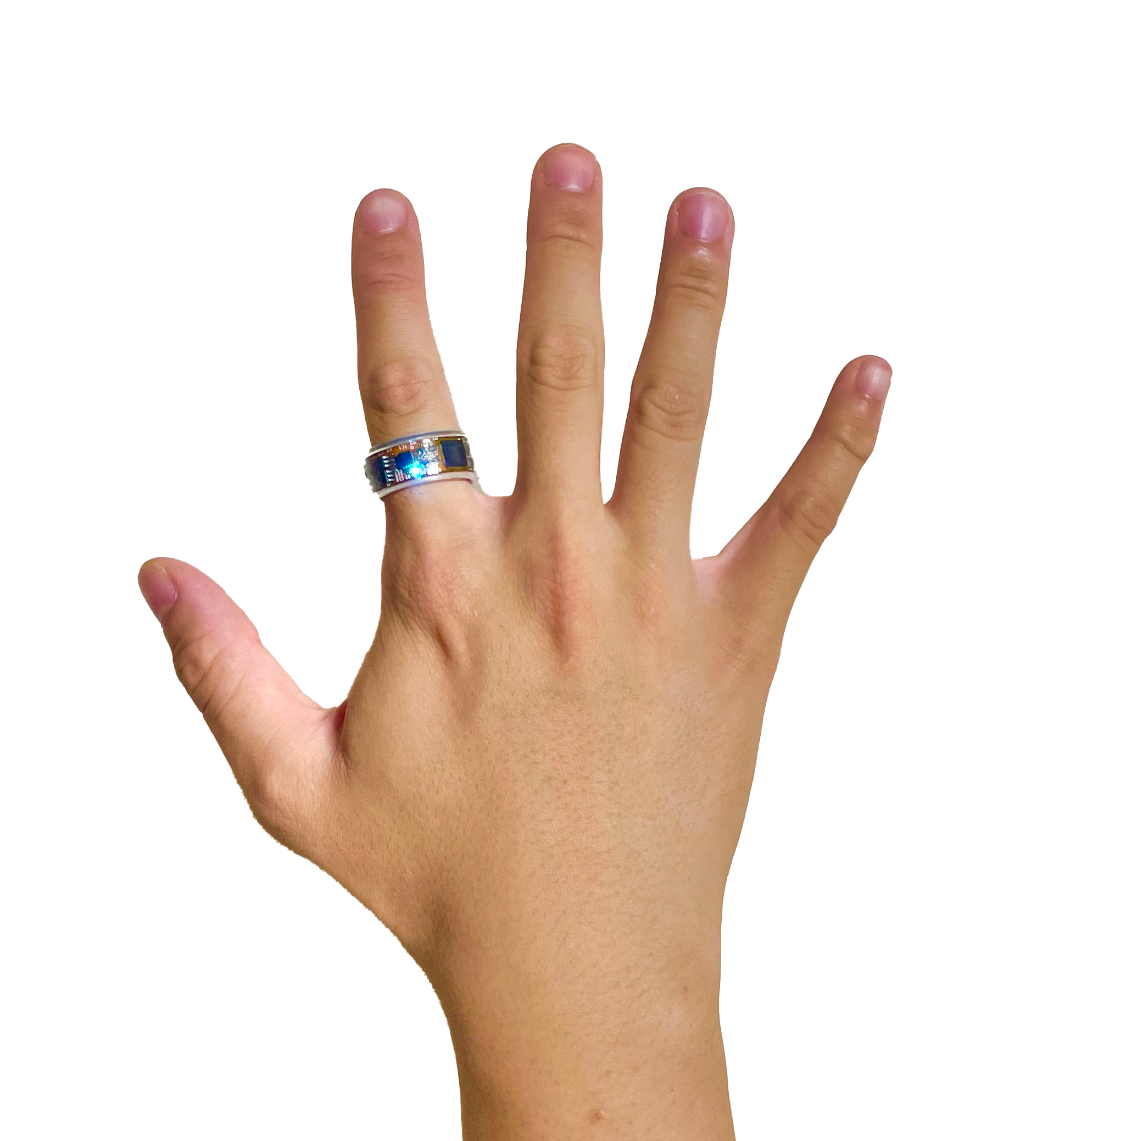
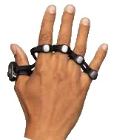
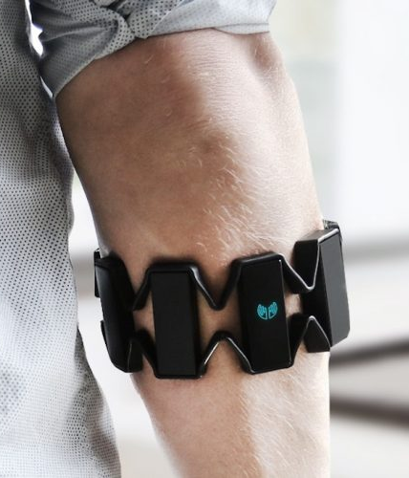
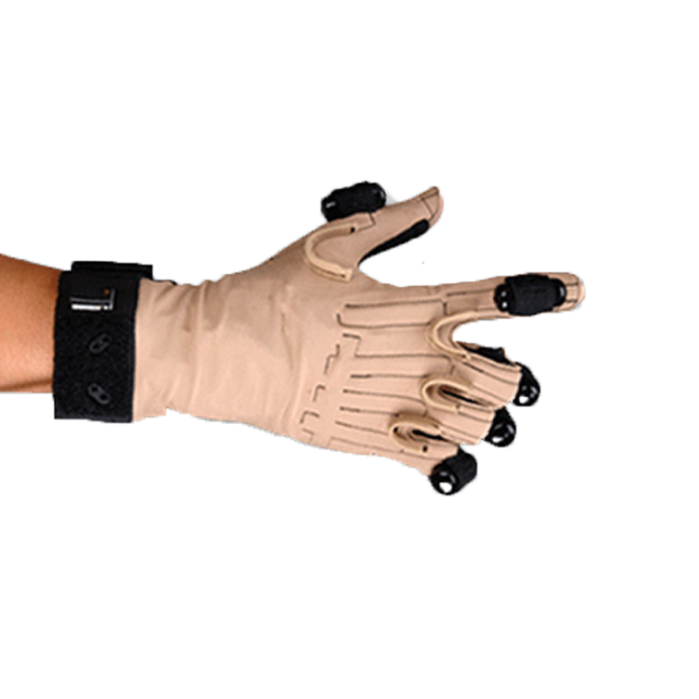
Ring (Zip)
Tapstrap
Platform
Comfort
Weight
Appearance
Platform
Comfort
Weight
Appearance
9.5
9.8
9.7
7.2
6.6
7.4
Myo EMG
CyberGlove
Platform
Comfort
Weight
Appearance
Platform
Comfort
Weight
Appearance
8.0
6.4
3.6
4.2
2.2
6.4

Slide 5
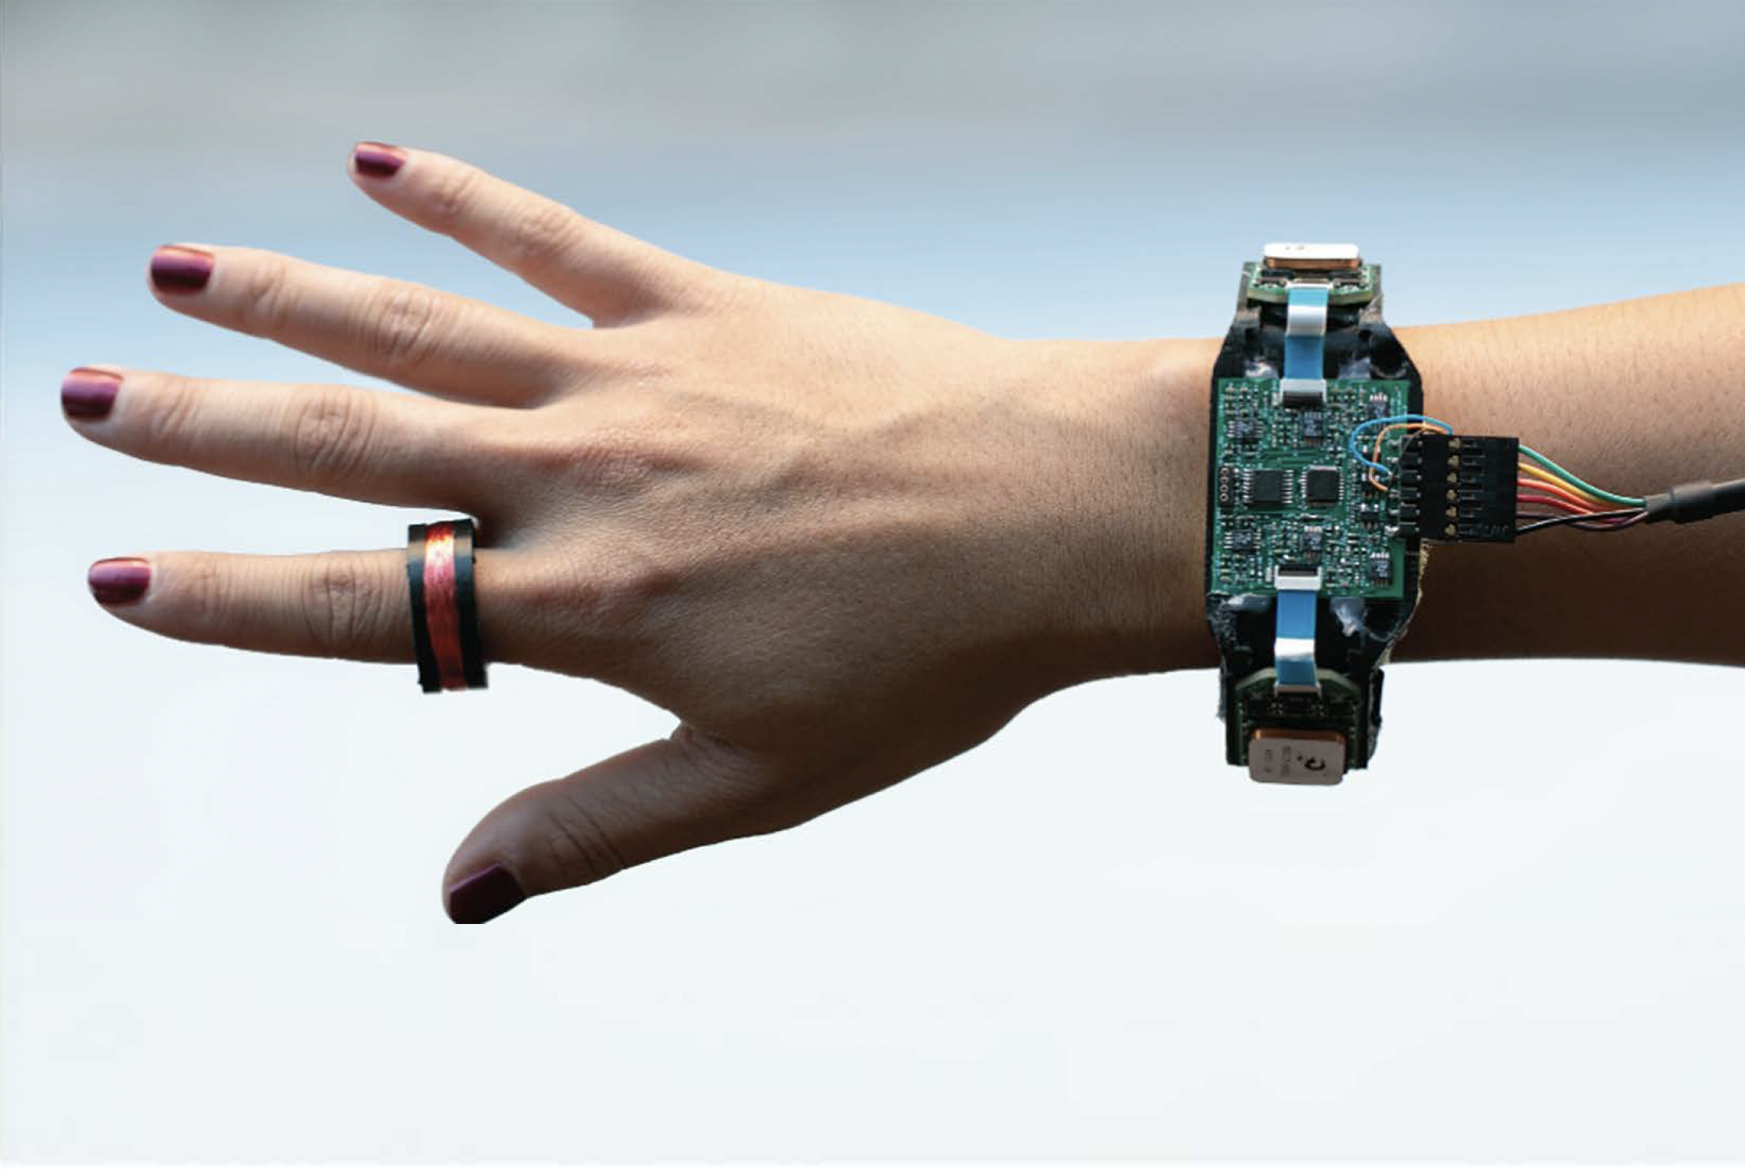
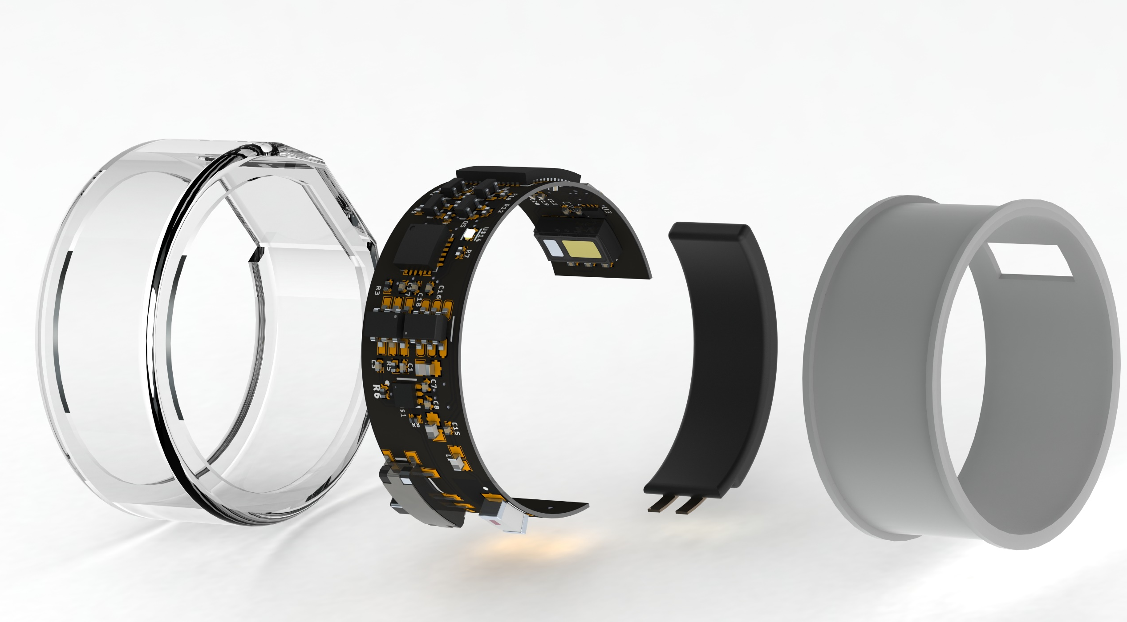
(a)
(b)

Slide 6
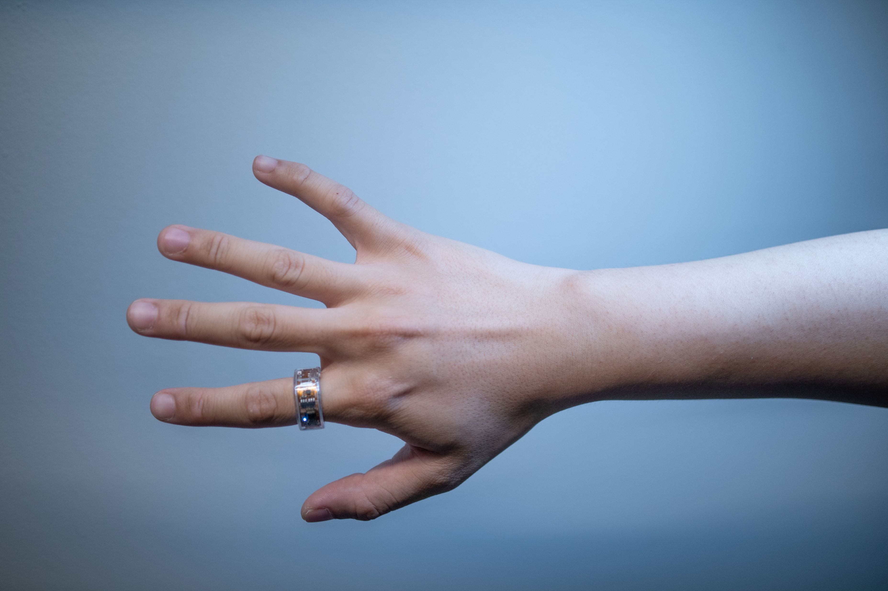

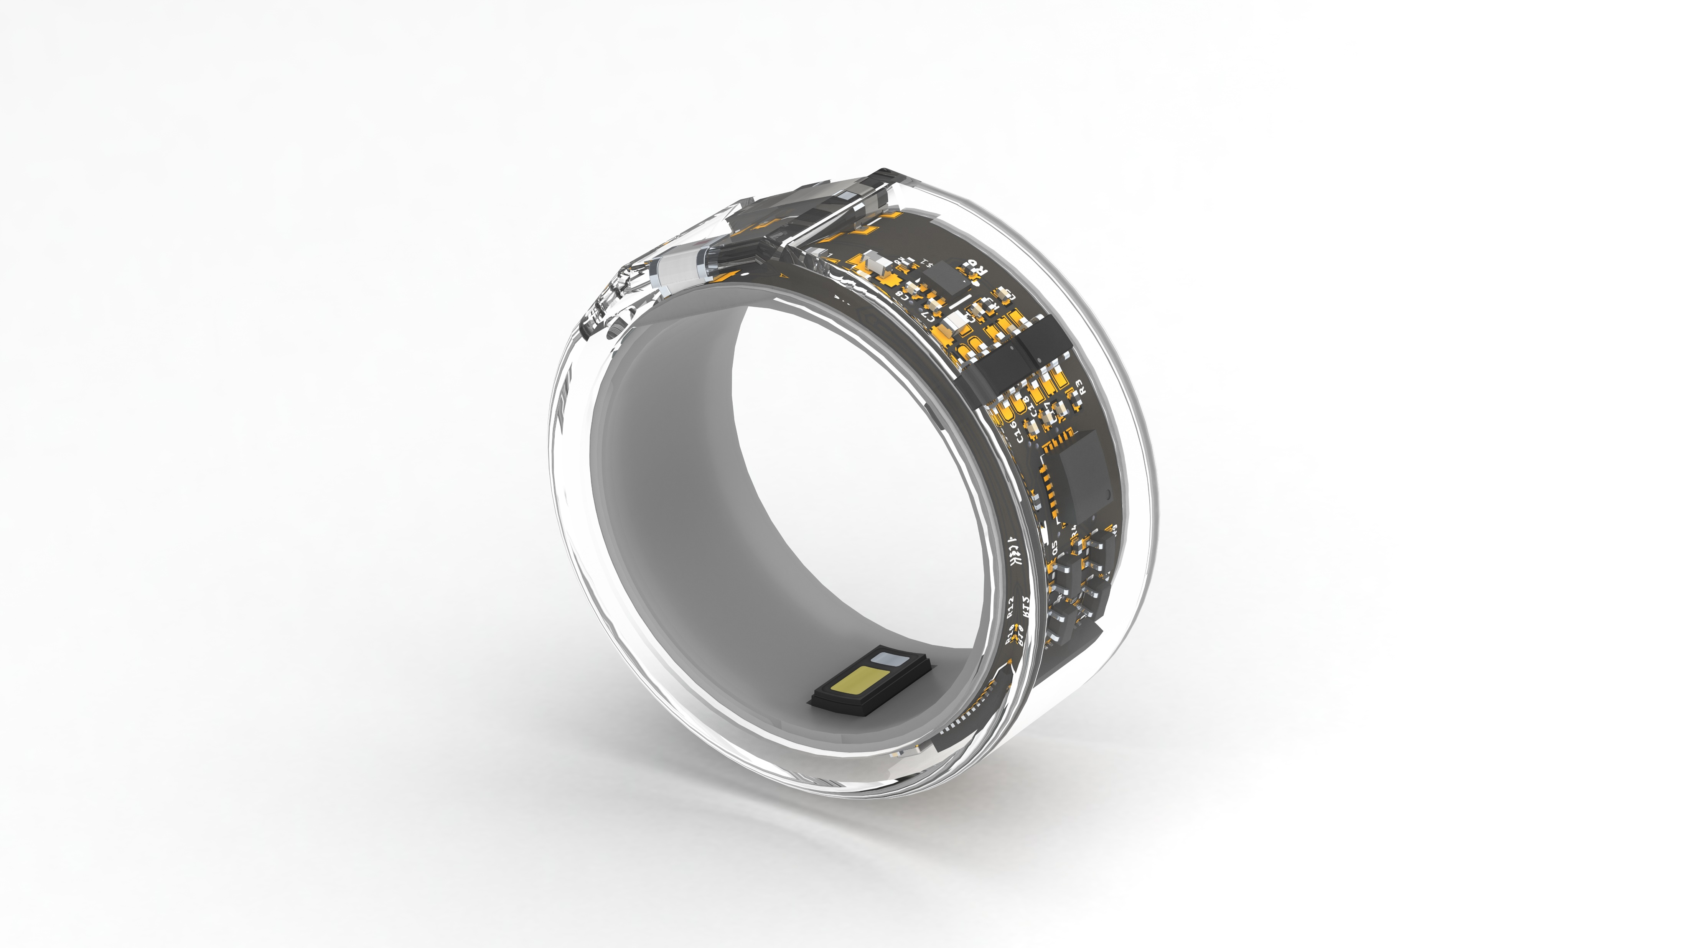


Slide 7

Ring Cover
Arc Battery
Main Board
Arc Battery

Slide 8

Ring Cover
Arc Battery
Main Board
Arc Battery

Slide 9


Outer Cover
Arc Battery
Main Board
Inner Cover

Slide 10
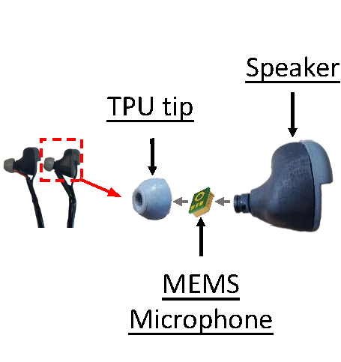
(a) OmniRing
(b) EARFace
(c) Cricket

Slide 12
